Slide 1
Accessing TESS Data Programmatically: A MAST case study
Clara Brasseur
22 July, 2019

Slide 2
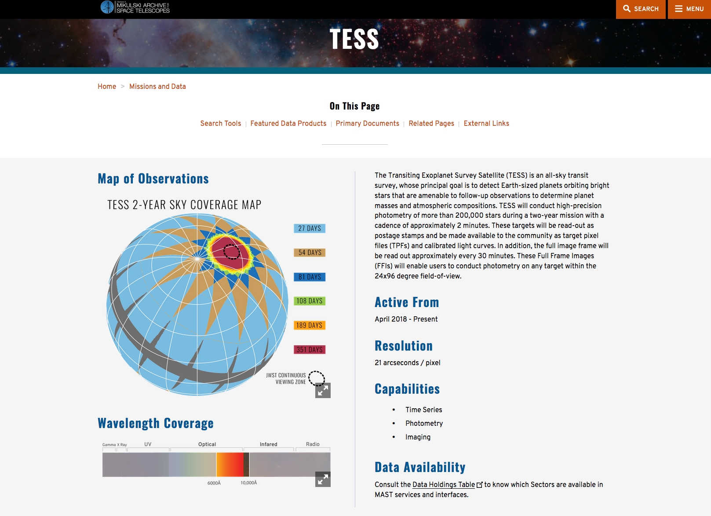
MAST Archives TESS

Slide 3
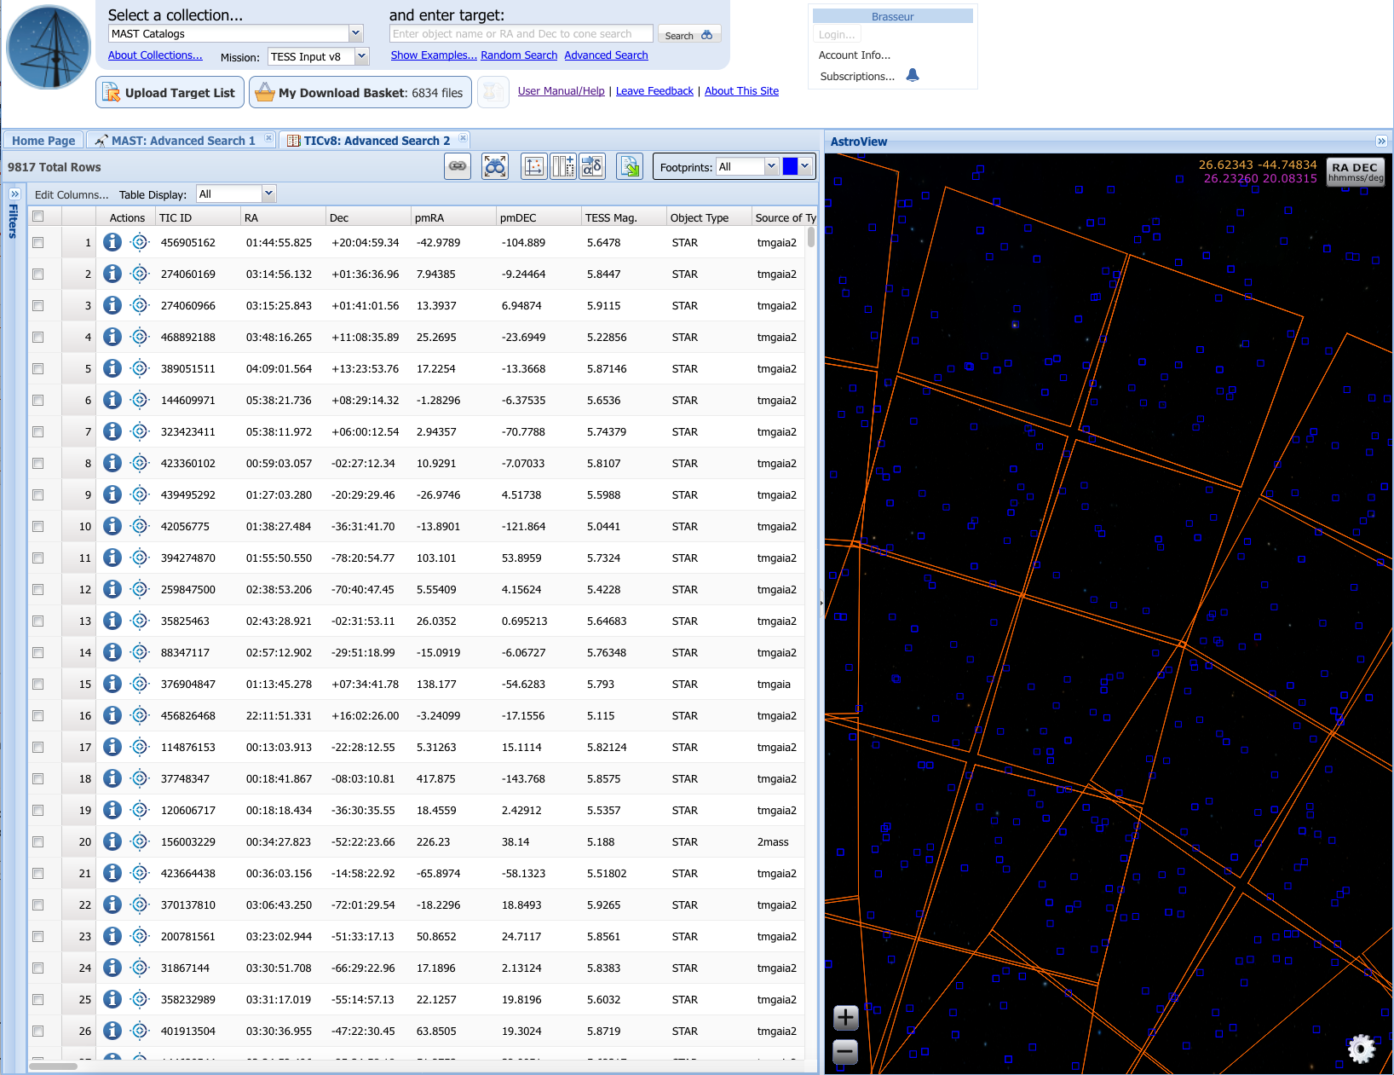
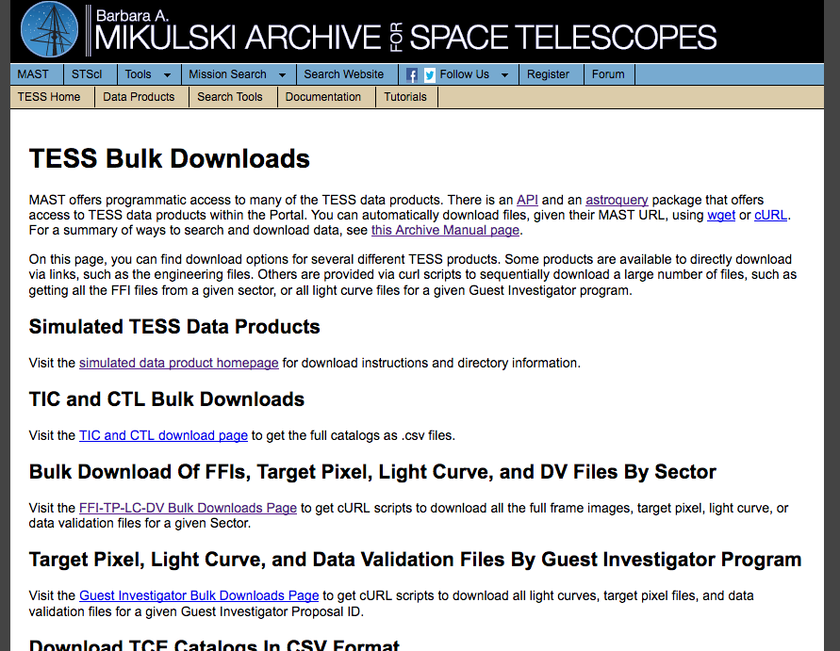
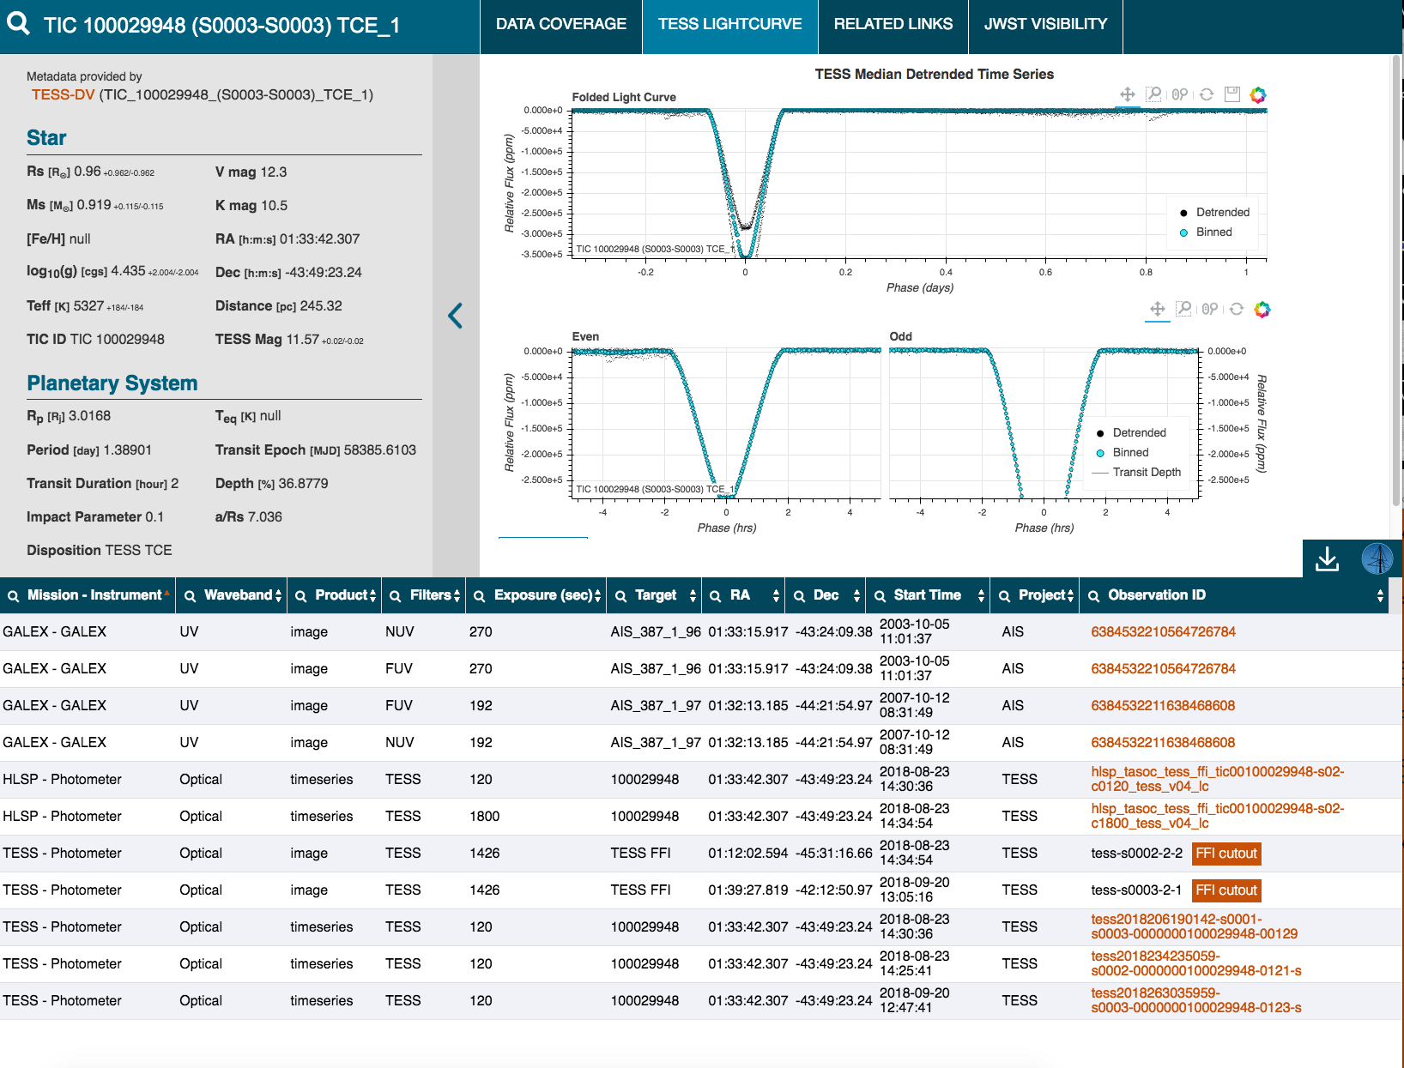
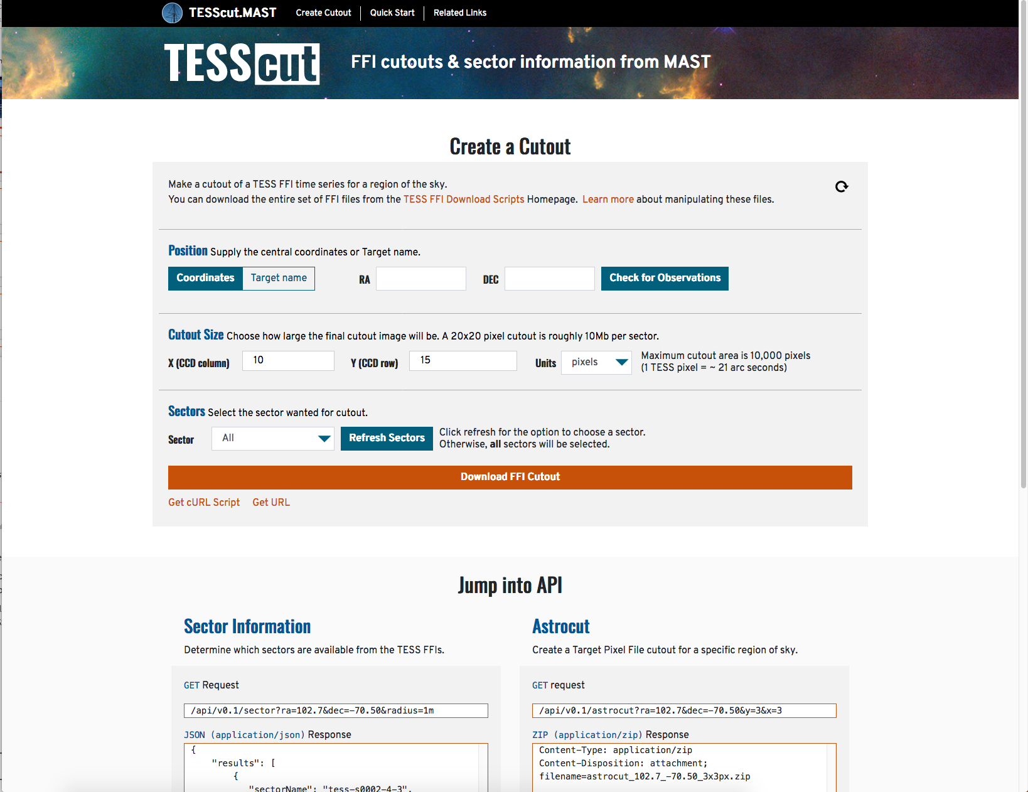
Web Interfaces

Slide 4
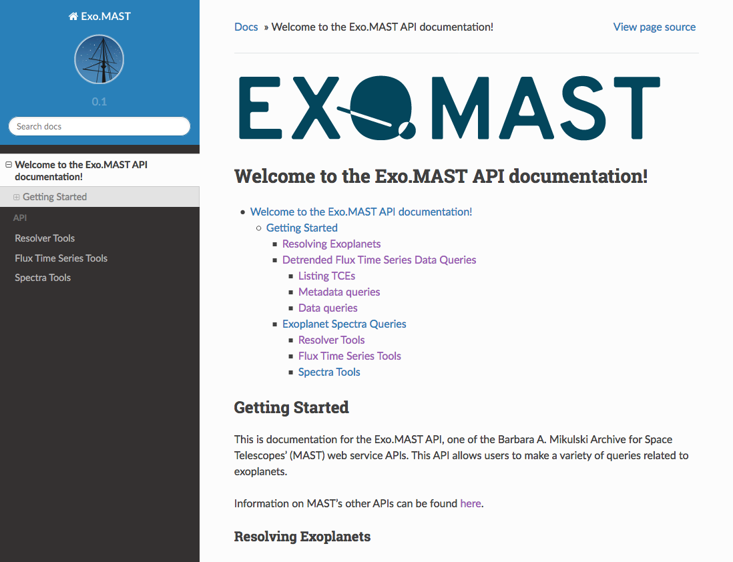
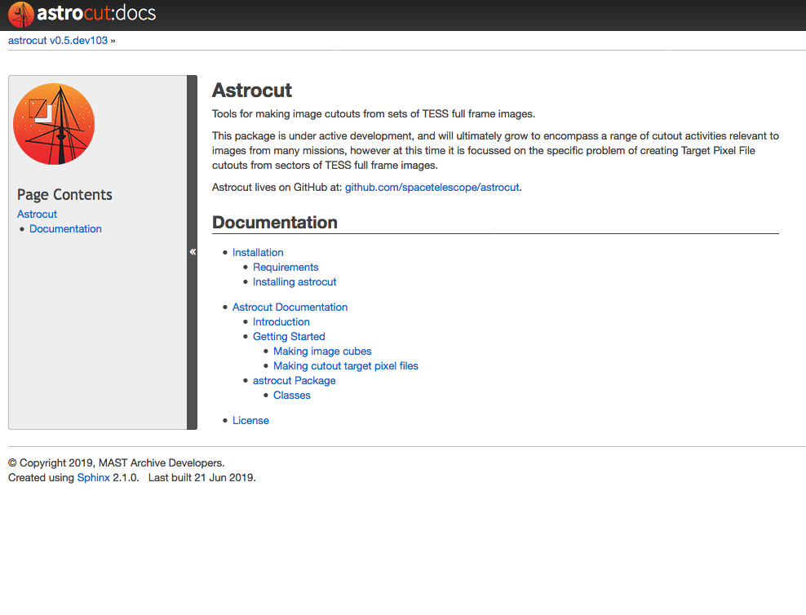
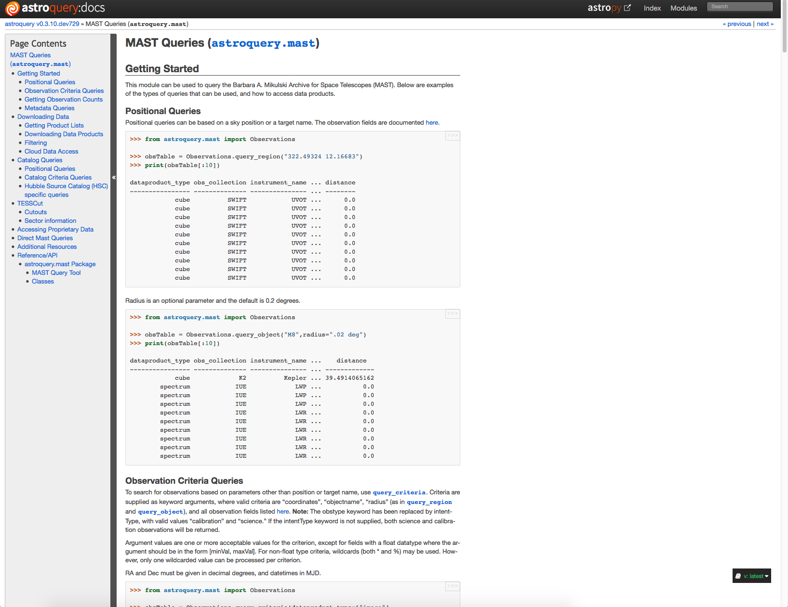
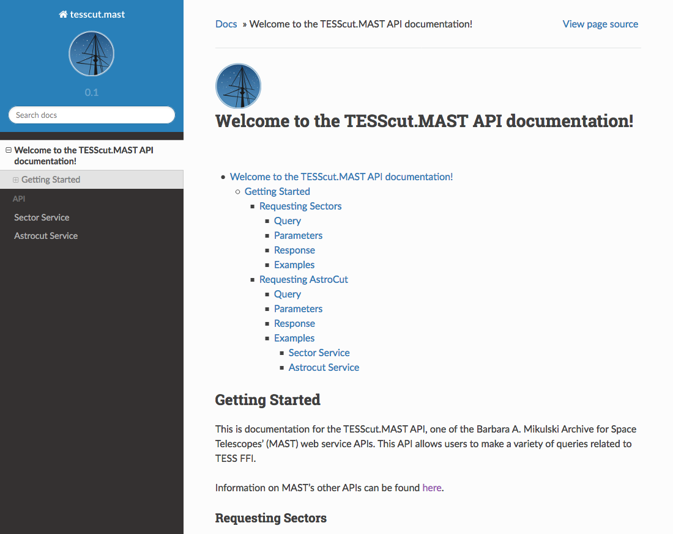
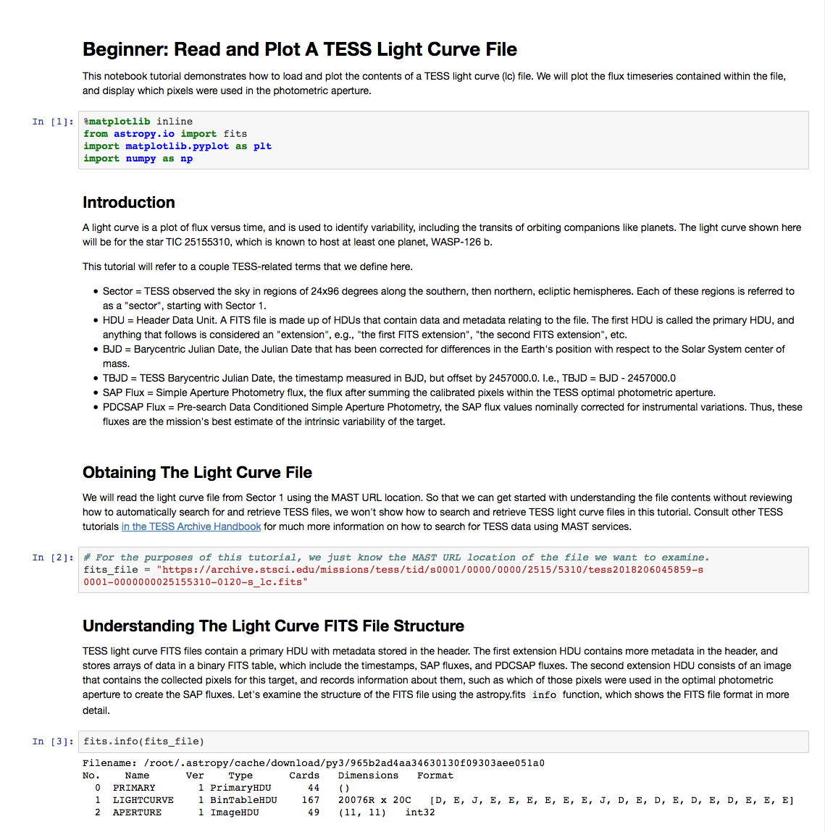
Programmatic Interfaces

Slide 5
Scientific Case Study

Slide 6
Important Links
These materials: github.com/ceb8/tasc5
Main TESS page at MAST: archive.stsci.edu/tess
GUI interfaces
The MAST Portal (general data access): mast.stsci.edu
ExoMAST (exoplanet oriented): exo.mast.stsci.edu
TESScut (cutouts): mast.stsci.edu/tesscut
Bulk downloads: archive.stsci.edu/tess/bulk_downloads.html
Programmatic interfaces
MAST Astroquery (python): astroquery.readthedocs.io/en/latest/mast/mast.html
Jupyter notebooks (examples): spacetelescope.github.io/notebooks
Astrocut (offline cutouts): astrocut.readthedocs.io
Non-python APIs:
mast.stsci.edu/api/v0/ (MAST Portal API)
exo.mast.stsci.edu/docs/ (ExoMAST API)
mast.stsci.edu/tesscut/docs/ (TESScut API)

